Slide 1
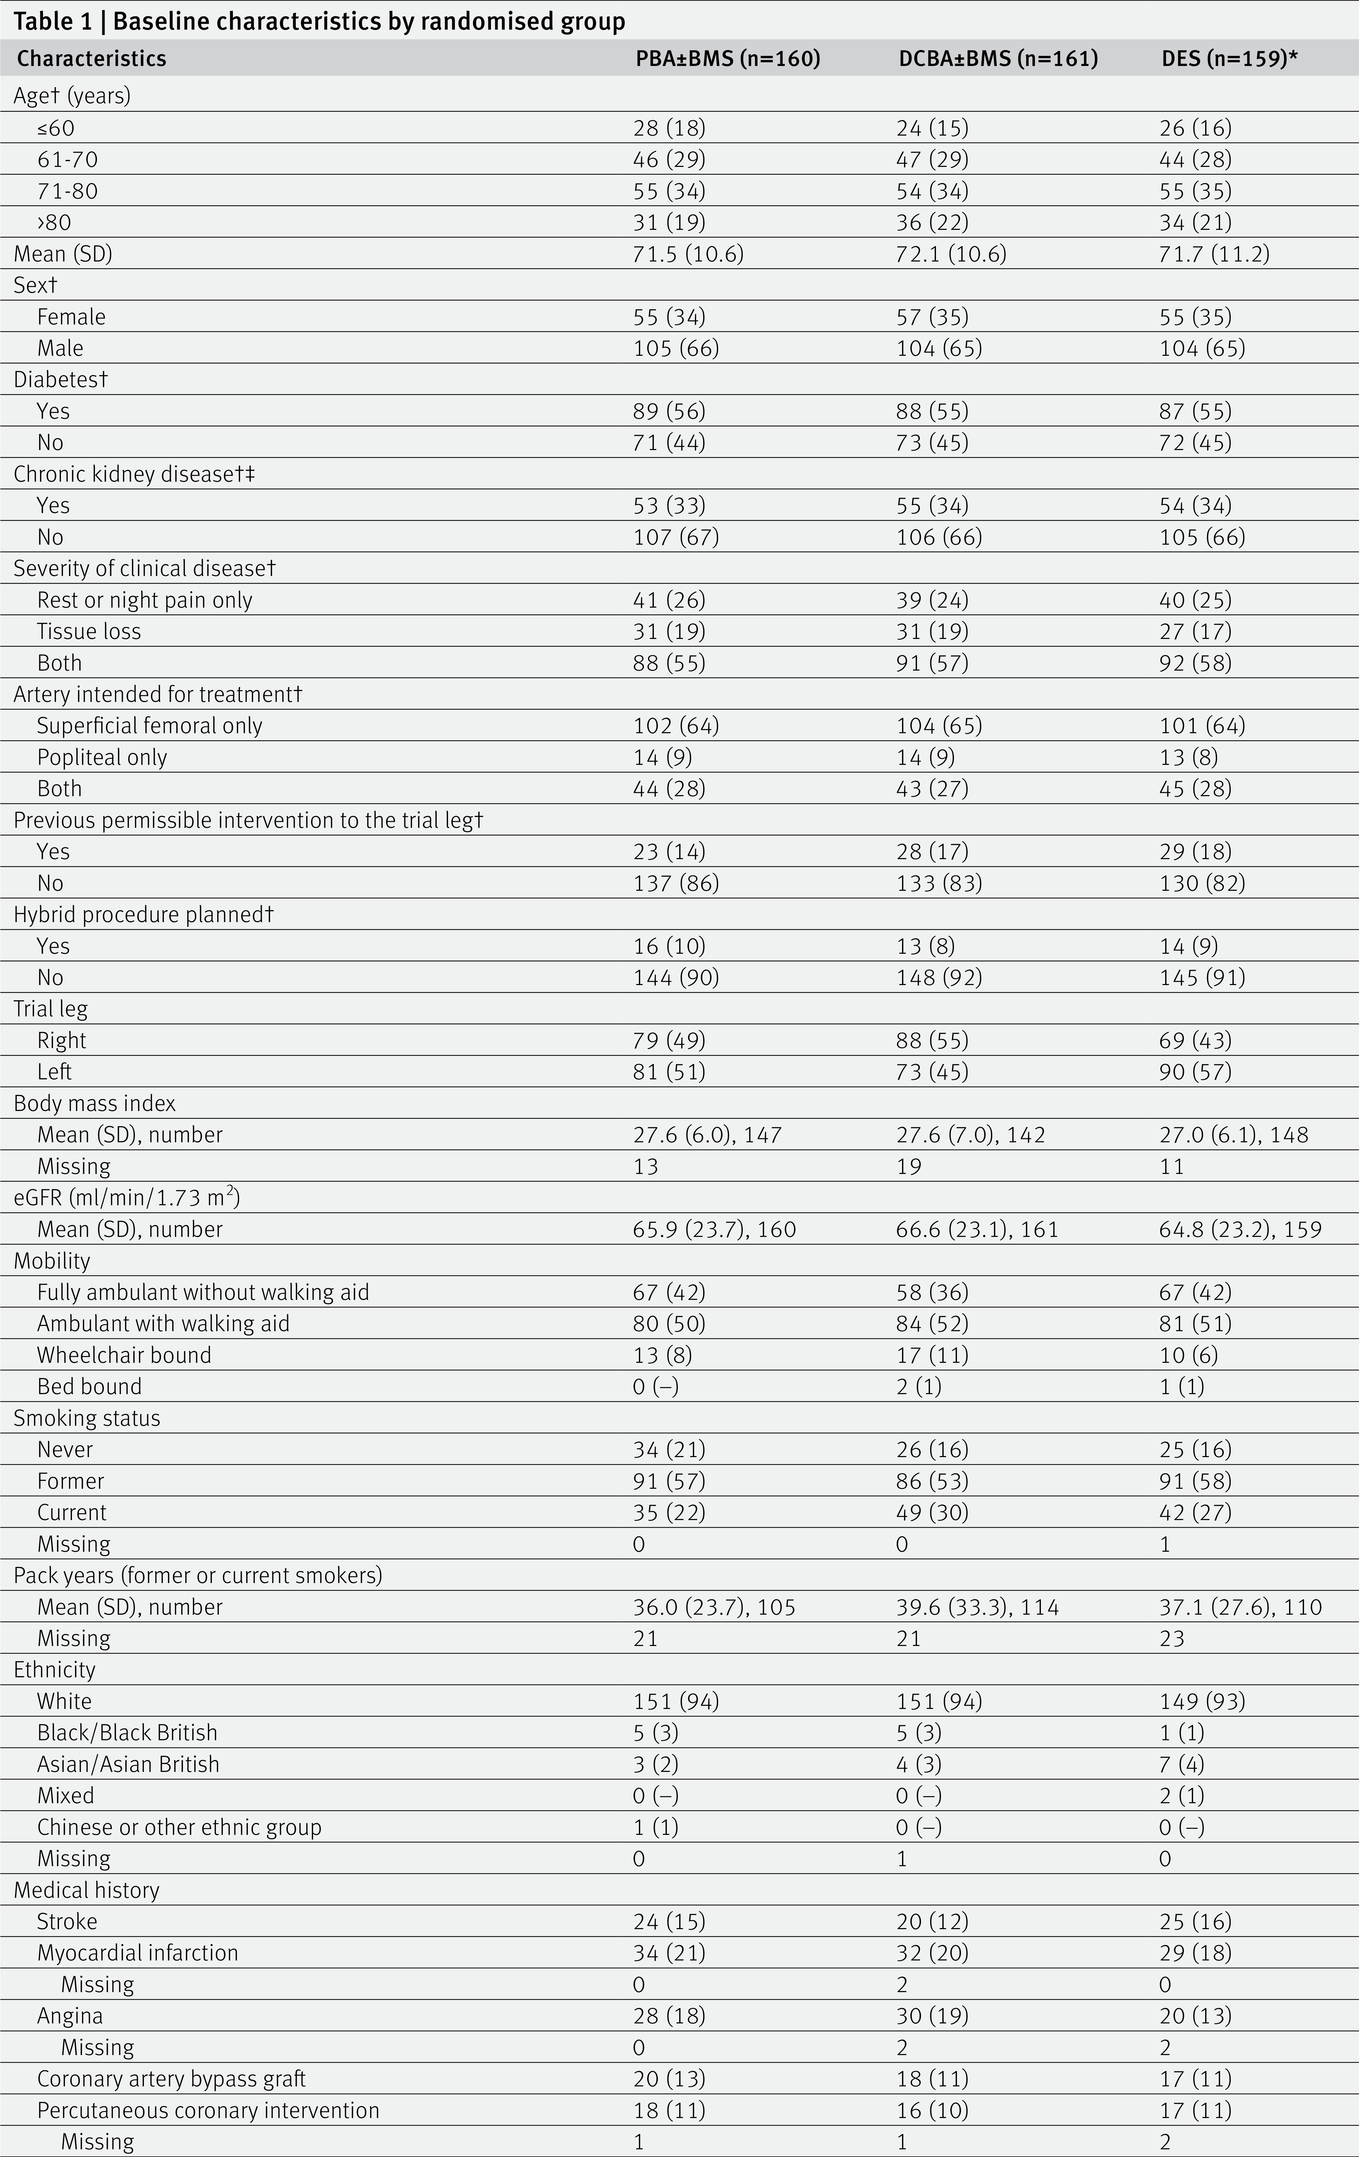
Table 1 | Baseline characteristics by randomised group

Slide 2
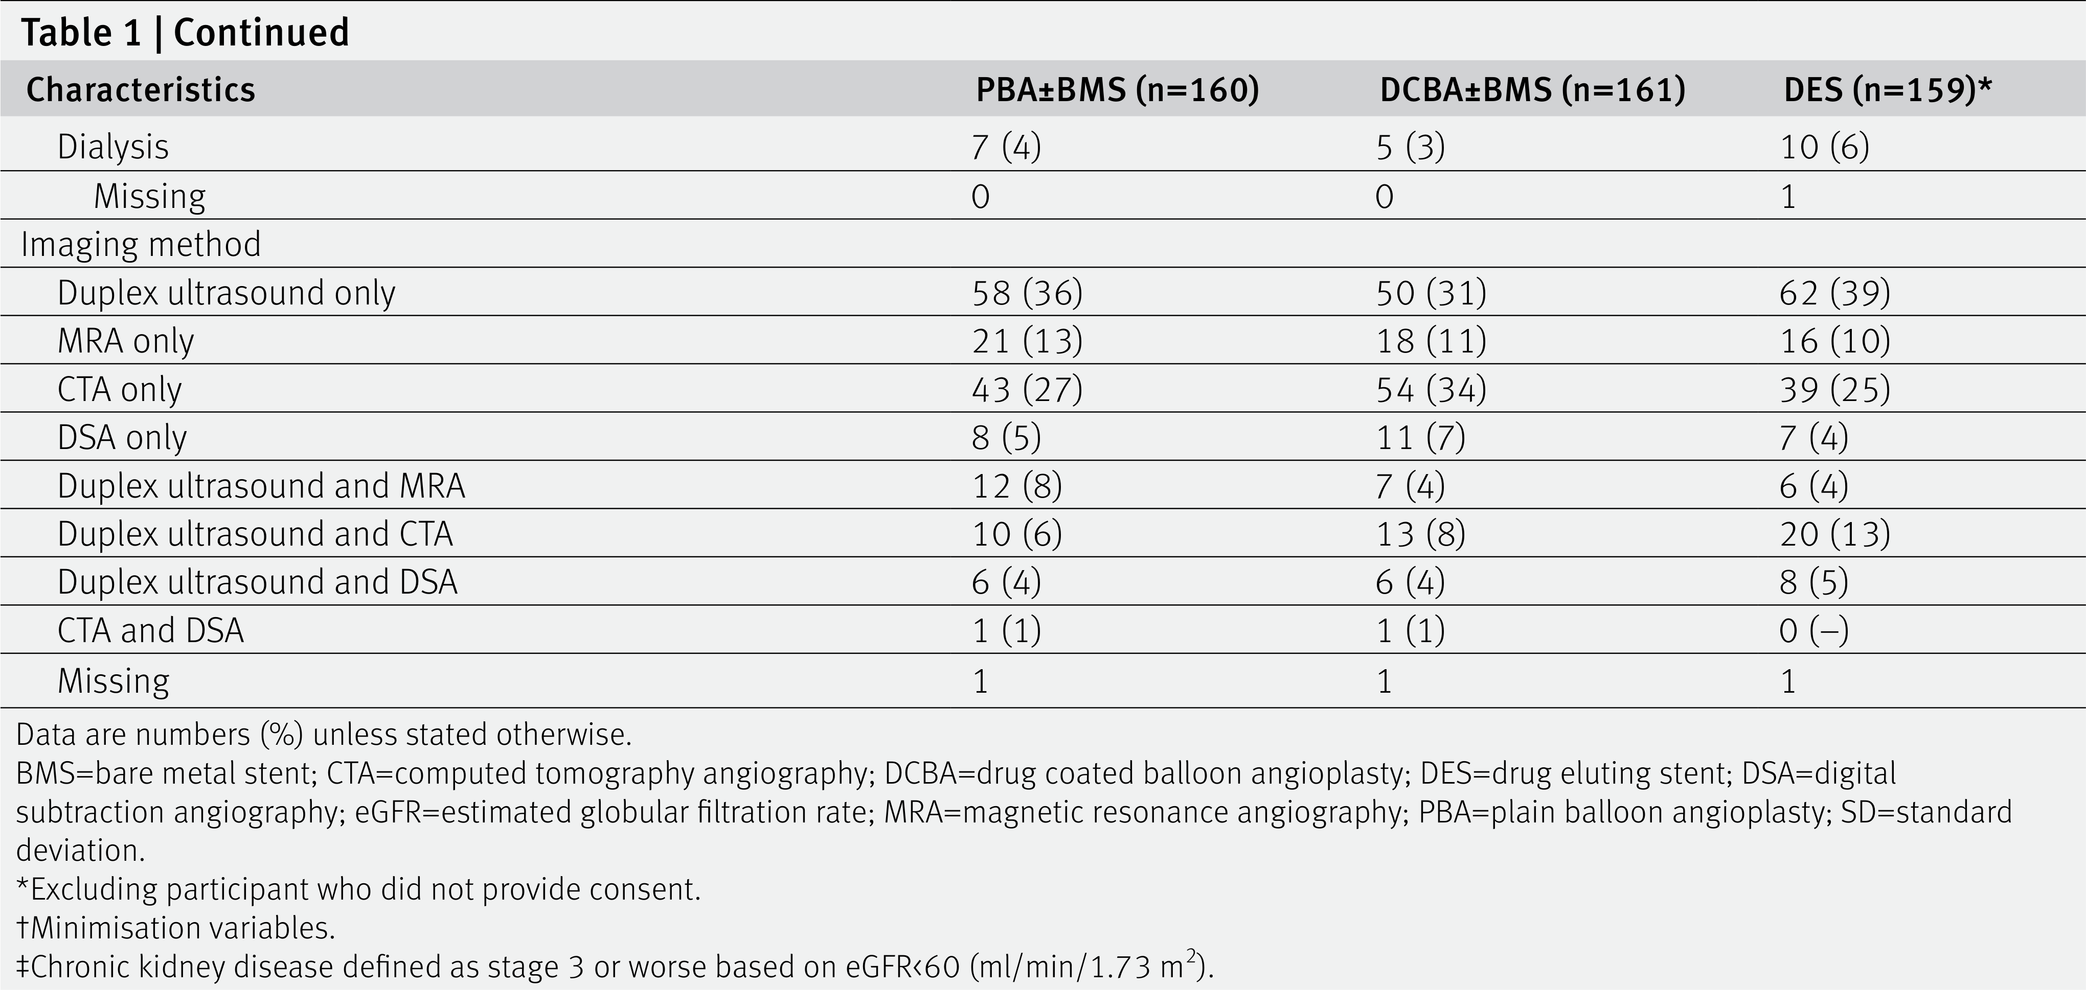
mortality in patients treated with a paclitaxel DCBA or DES.12 The UK Medicine and Healthcare products Regulatory Agency convened an expert advisory group, which concluded that paclitaxel devices could still be used in patients with chronic limb threatening ischaemia and recommended that BASIL-3 resume recruitment. With support from the funder and the trial steering committee, including PPI members, new ethical approval was obtained, and BASIL-3 reopened to recruitment on 16 September 2019 (table S1 gives more timeline details). One participant was randomised to DES without written informed consent and so was removed from all analyses. Of the 480 participants included in the analyses, 167 (35%) were women, and the mean age was 71.8 years (standard deviation 10.8; table 1, table 2). A total of 464 (97%) participants received an endovascular procedure as their first revascularisation, with 444 (93%) of these being at least to the superficial femoral artery, the popliteal artery, or both. Three participants received a surgical revascularisation and 13 received no revascularisation. The allocated device was used in 142 (92%), 127 (82%), and 118 (76%) first endovascular interventions (in any femoro- popliteal artery) in the PBA±BMS, DCBA±BMS, and DES groups, respectively. This gave overall adherence rates of 140 (88%) for PBA±BMS, 122 (76%) for DCBA±BMS, and 118 (74%) for DES. A total of 426 (91%) participants received their first revascularisation within two weeks of randomisation and the median time to first intervention after randomisation was 0 days (interquartile range 0-3 days) in all three groups. Further details of the first revascularisation procedure including devices used and arterial segments treated can be found in the supplementary appendices (table S2). No patients were reported as having treatment using intravascular ultrasound as an adjunct, or with non-drug specialty balloons, or with atherectomy (such devices were not part of the protocol and were rarely used during the trial recruitment period in the UK). (continued)

Slide 3
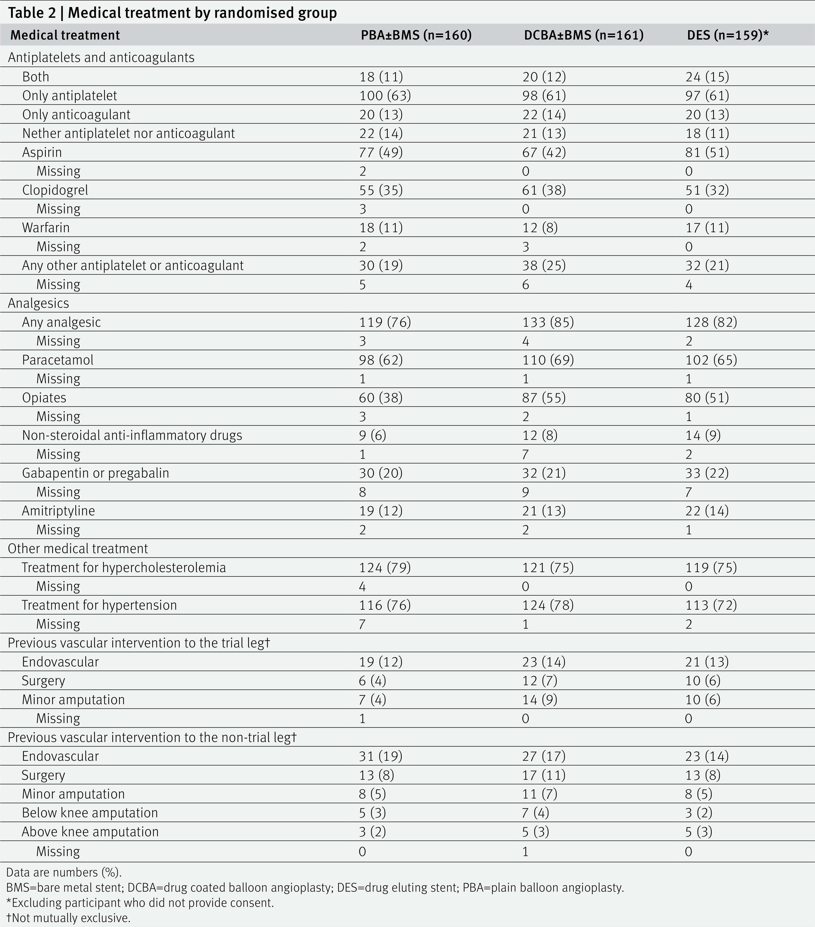
The median time to last clinical follow-up was 2.1 years (range 0-7.2 years) for all participants, and 3.1 years (range 0-7.2 years) in survivors. In the PBA±BMS group, 106/160 (66%) participants had a major amputation or died (no amputation free survival) compared with 97/161 (60%) in the DCBA±BMS group (adjusted hazard ratio from the Cox proportional hazards model 0.84; 97.5% confidence interval 0.61 to 1.16; P=0.22), and 93/159 (58%) in the DES group (0.83, 0.60 to 1.15; P=0.20; table 3, fig 2). The median amputation free survival time was 3.16, 3.52, and 4.29 years in the PBA±BMS, DCBA±BMS, and DES groups, respectively. The absolute differences in failure probabilities and corresponding numbers needed to treat were −0.042 (97.5% confidence interval −0.164 to 0.079), NNTB 24 (NNTB 6 to ∞ to NNTH 13) and

Slide 4
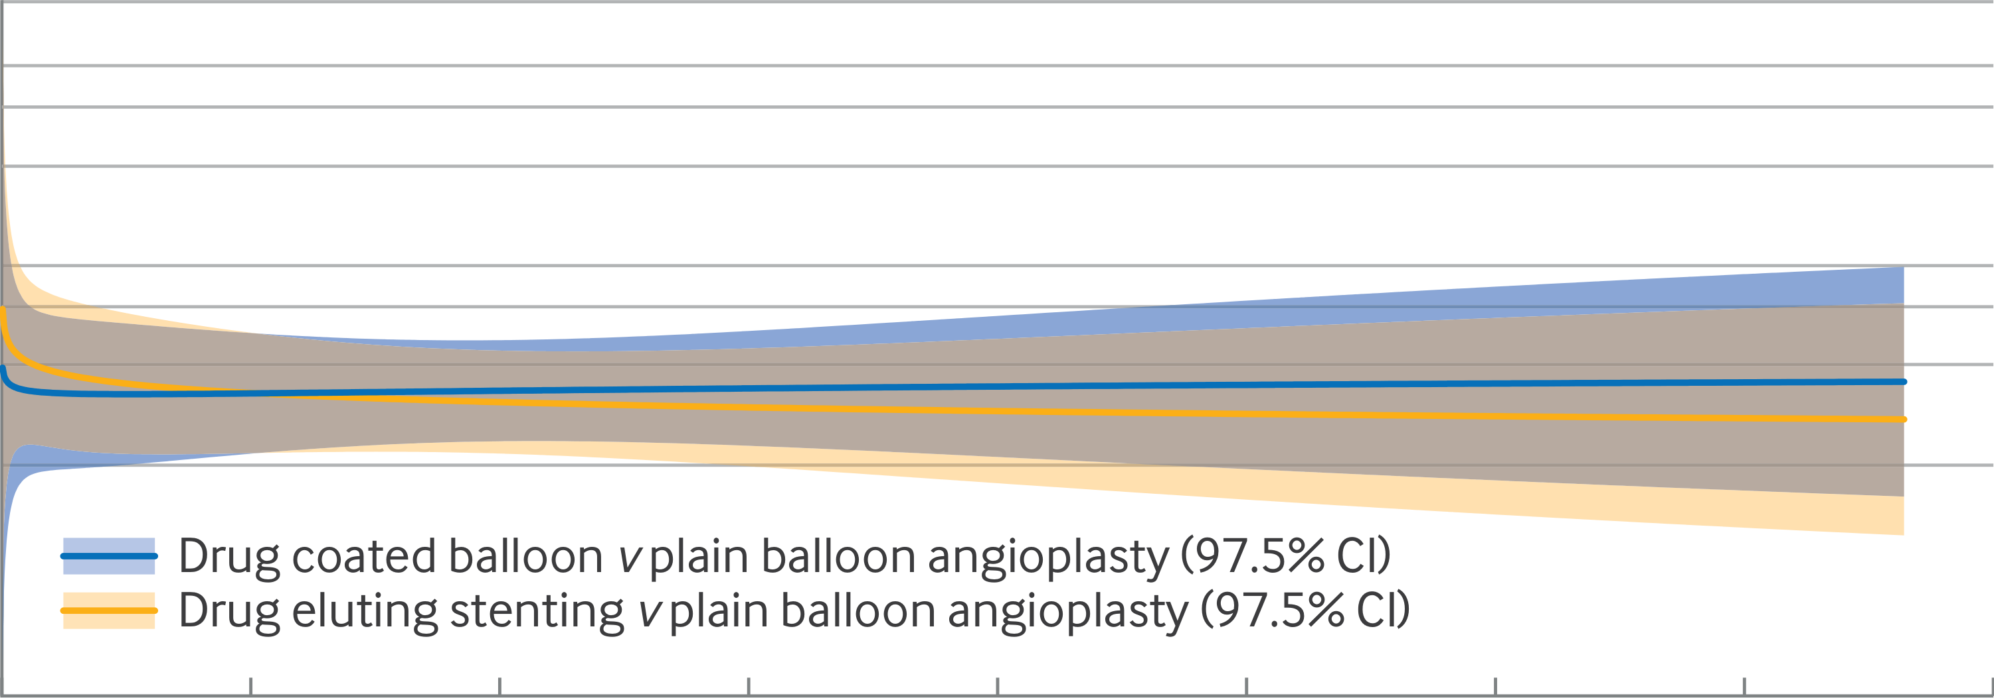
Fig 2 | Amputation free survival (AFS) Kaplan-Meier plot and hazard ratio over time fitted assuming non-proportional hazards (intention-to-treat analysis). CI=confidence interval (continued)

Slide 5
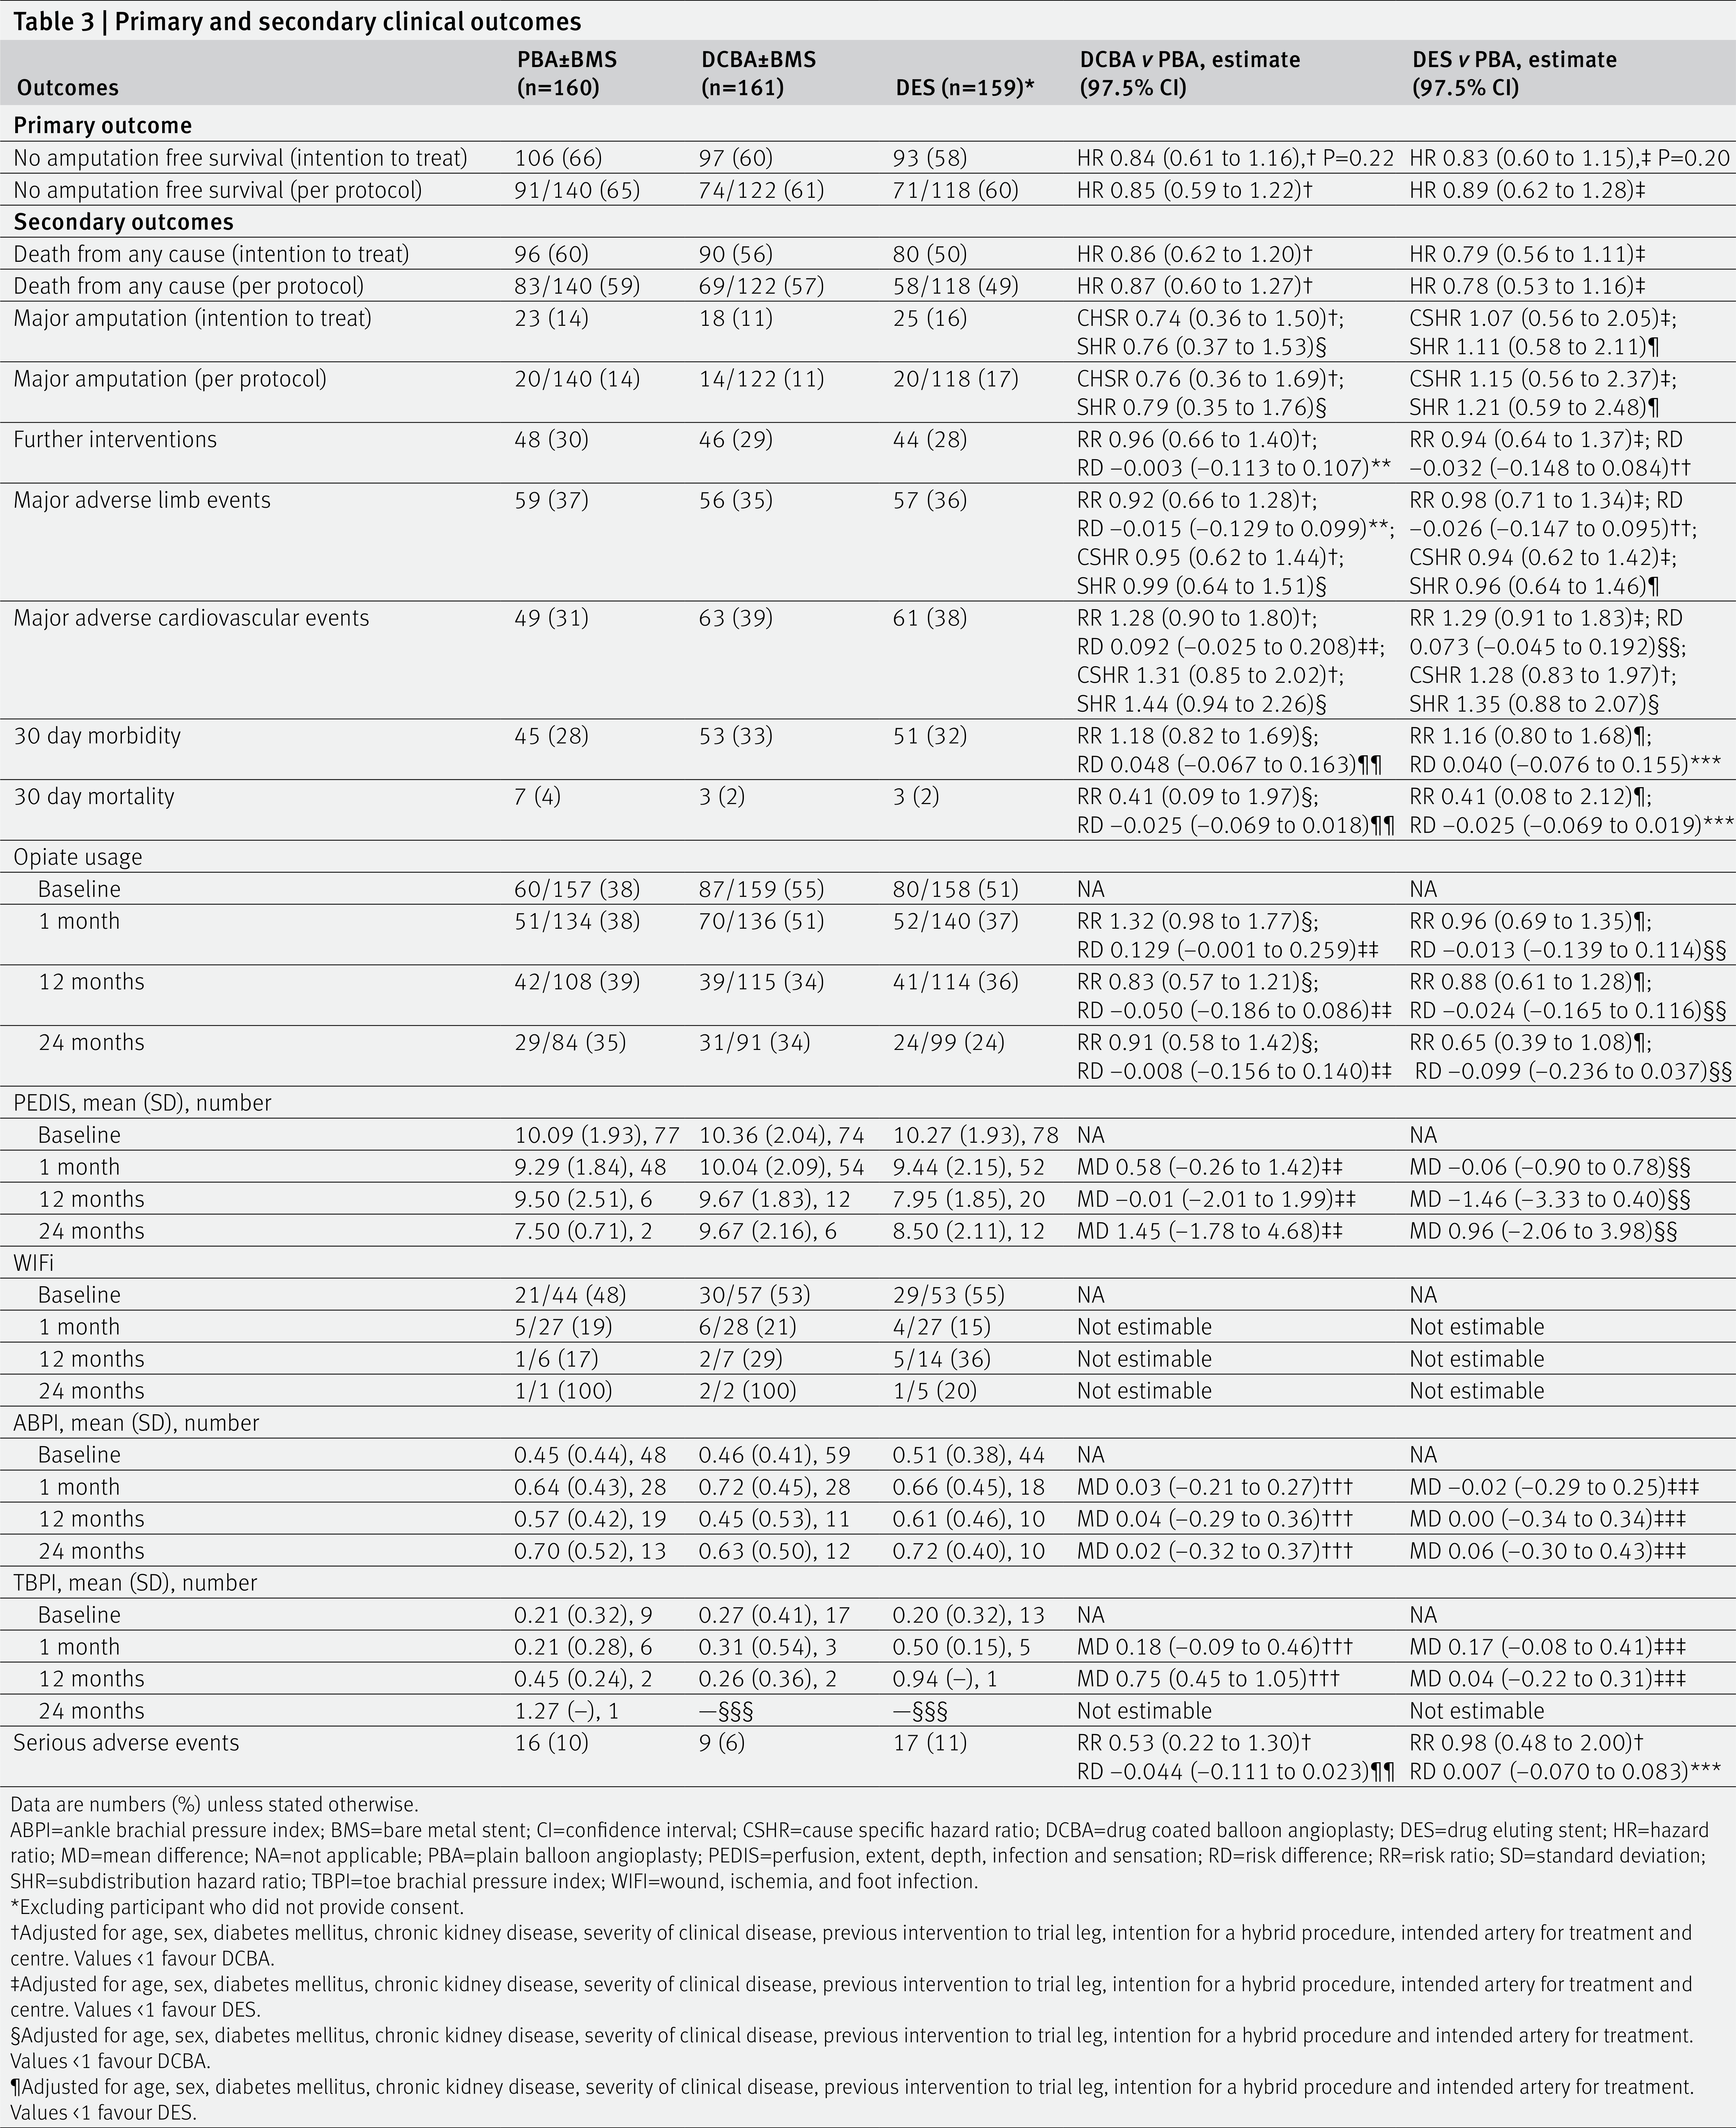
Table 3 | Primary and secondary clinical outcomes

Slide 6
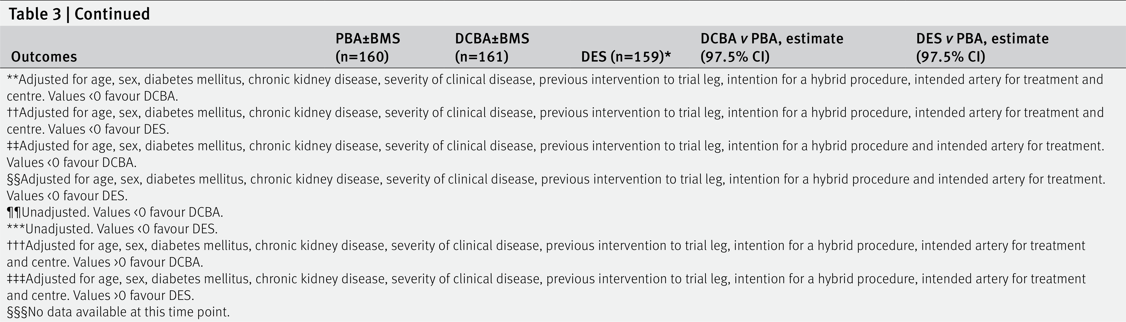
results (table 3). No differences were observed between the treatment groups relating to further interventions, 30 day morbidity and death, major adverse limb events, major adverse cardiovascular events, relief of ischaemic pain, or health related quality of life (table 3, table 4, table S6, and figures S2-S5). In the PBA±BMS group, 16/160 (10%) participants had a serious adverse event compared with 9/161 (6%) in the DCBA±BMS group and 17/159 (11%) in the DES group. One serious adverse event was considered related to the trial intervention and was unexpected (hospital admission with epistaxis resolved with sphenopalatine artery ligation). Table S7 presents further serious adverse event details. Most causes of death were reported as multifactorial and often related to several comorbidities (table S8). (continued)

Slide 7
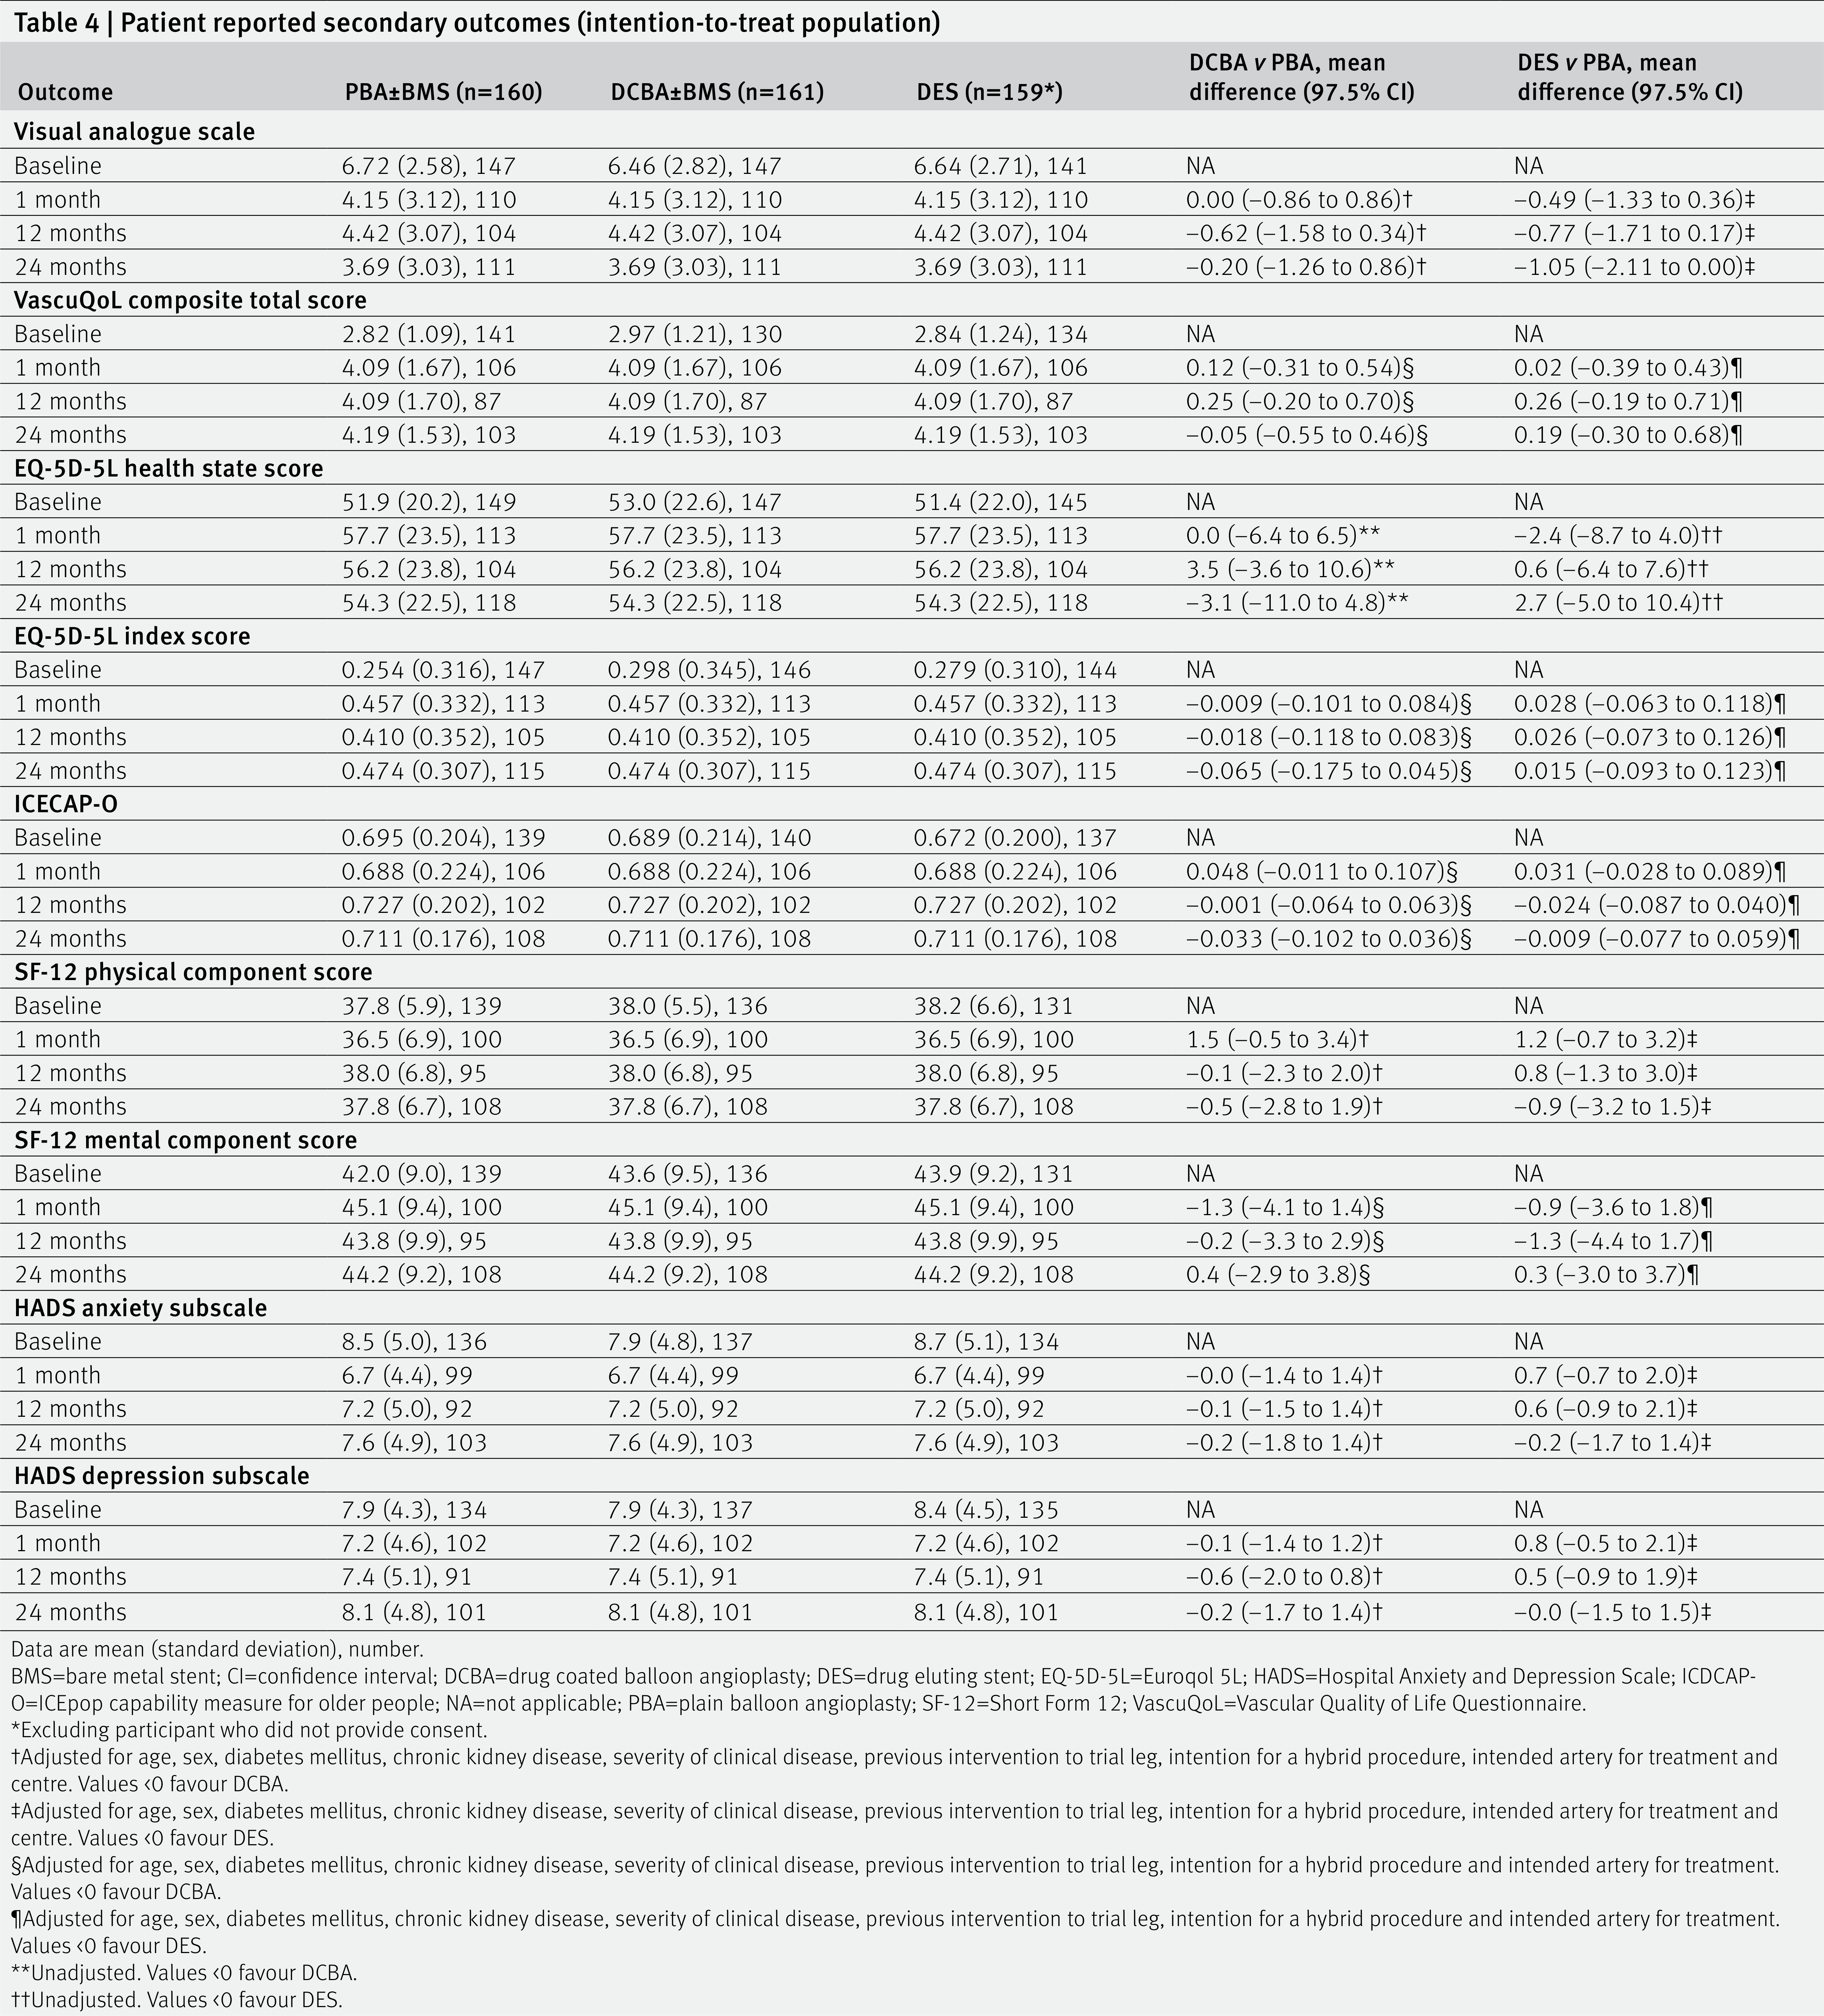
Table 4 | Patient reported secondary outcomes (intention-to-treat population)

